Slide 1
CHAPTER 8
Bivariate Correlational Research

Slide 2
An Introduction to Correlational Research
Goal: To establish that a relationship exists between variables and to describe the nature of the relationship
  Relationships can be described—not explained
  There is no attempt to manipulate, control, or interfere with the variables
  Testing pre-existing relationships!

Slide 3
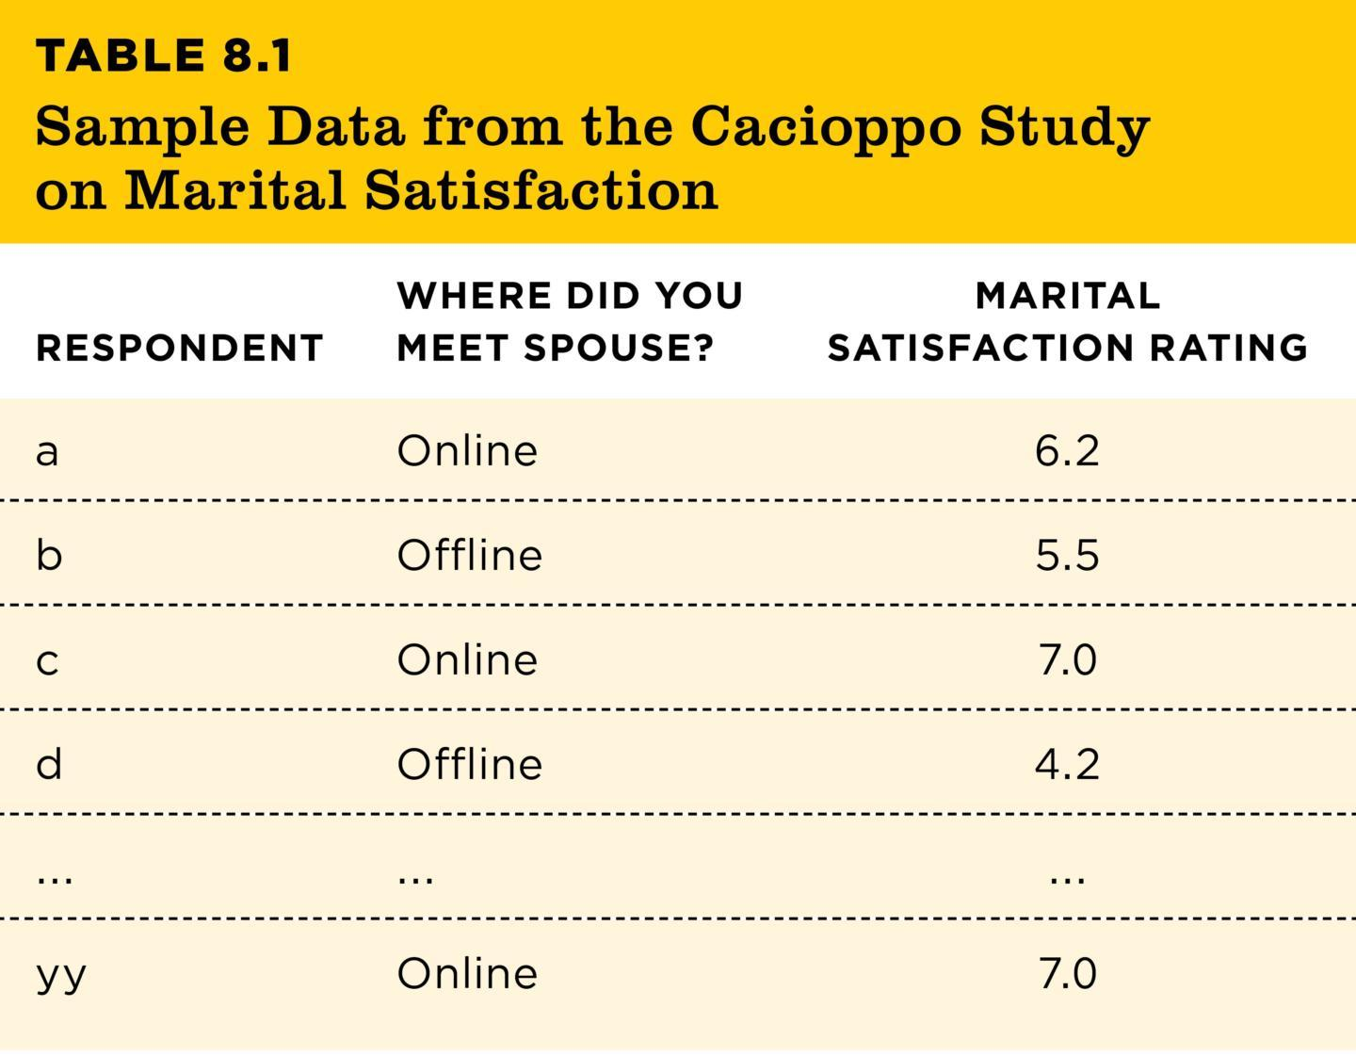
Introducing Bivariate Correlations (1 of 2)
Bivariate correlations: associations that involve exactly two variables
TABLE 8.1
TABLE 8.1 Sample Data from the Cacioppo Study on Marital Satisfaction
RESPONDENT | WHERE DID YOU MEET SPOUSE? | MARITAL SATISFACTION RATING
a | Online | 6.2
b | Offline | 5.5
c | Online | 7.0
d | Offline | 4.2
... | ... | ...
yy | Online | 7.0
Note: Data are fabricated for illustration purposes. Source: Adapted from Cacioppo et al., 2013.
Notes:
Table 8.1: Sample Data from the Cacioppo Study on Marital Satisfaction
Bivariate correlations: also called bivariate associations
This is a data table from the text. Each row of the table shows one person’s score on two measured variables. Even though each study measured more than two variables, a bivariate correlation only examines two variables at the same time.
Copyright © 2025 W. W. Norton & Co., Inc.

Slide 4
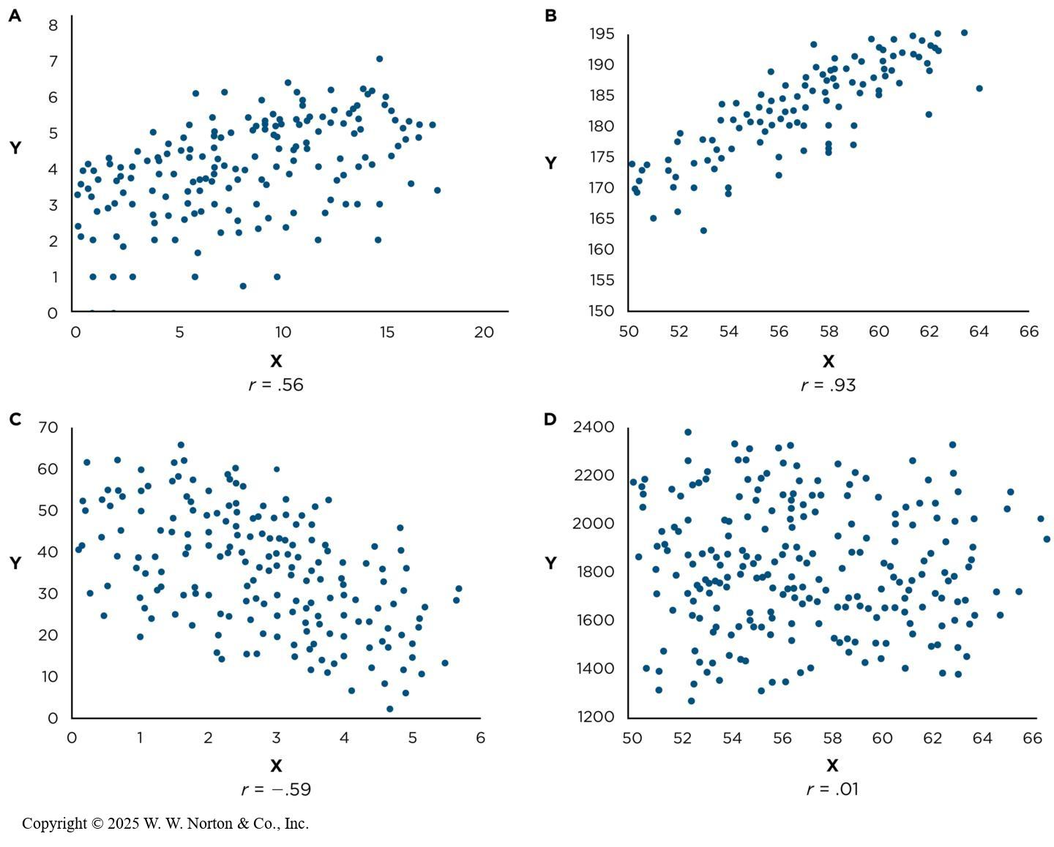
Correlations
To what extent are two variables related?
Measures the general pattern of responses
Notes:
Figure 5.3: Correlation Coefficients
Notice the differences in the correlation coefficient (r) in these scatterplots. The correlation coefficient describes both the direction and the strength of the association between the two variables, regardless of the scale on which the variables are measured.
Although scatterplots are a good first step in evaluating reliability, a more common and more efficient way is to use the correlation coefficient.
Correlation coefficient (r): This is a single number that describes how close the dots on a scatterplot are to the line drawn through them.
Slope direction: Notice that the direction of the slope is different in the four scatterplots. A and B show an upward slope from left to right (positive slope); C shows a downward slope (negative slope); and D does not slope either up or down (zero slope).
Strength: The spread of the dots in a scatterplot corresponds to the strength of the relationship. When dots are close to the line, you have a strong relationship. When dots are spread out, you have a weak relationship. When your slope is positive, r is positive. When your slope is negative, r is negative; r ranges from -1.0 to +1.0. The stronger the relationship, the closer r is to -1.0 or +1.0. The weaker the relationship, the closer r is to 0. An r of 1.0 is the strongest positive relationship, an r of -1.0 is the strongest negative relationship, and an r of 0 or close to 0 is no relationship.
How Do Psychologists Use the Strength and Direction of r to Evaluate Reliability?
Test-retest reliability: Measure the same participants at least twice (Time 1 and Time 2) and then compute r. If r is strong and positive (.05 or above), then you have good test-retest reliability. If r is positive but weak, it is a sign of low test-retest reliability. Note that test-retest reliability is only relevant for variables that do not change over time. It wouldn’t be relevant for something like an organism’s weight.
Interrater reliability: Two observers rate the same participants at the same time and then an r is computed. If r is positive and strong (.70 or higher), you have good interrater reliability. If r is positive but weak, you do not have good interrater reliability. A negative r would mean terrible interrater reliability. Can you explain why? When observers are rating a quantitative variable, r is the appropriate statistic. However, when a variable is categorical, the appropriate statistic is a kappa.
3. Internal reliability: This is relevant for measures that use more than one item to tap into the same construct. A set of items has internal reliability if its items correlate strongly with one another. In that case, you can average across those items to get a single overall score for each participant.
Cronbach’s alpha is the statistic usually used to evaluate internal reliability.
Copyright © 2025 W. W. Norton & Co., Inc.

Slide 5
Things to Know about the Correlation Coefficient
It varies between -1 and +1
  0 = no relationship
  Closer to ± 1 = stronger
It shows direction
Positive r: variables change in same direction
Negative r: variables change in different directions

Slide 6
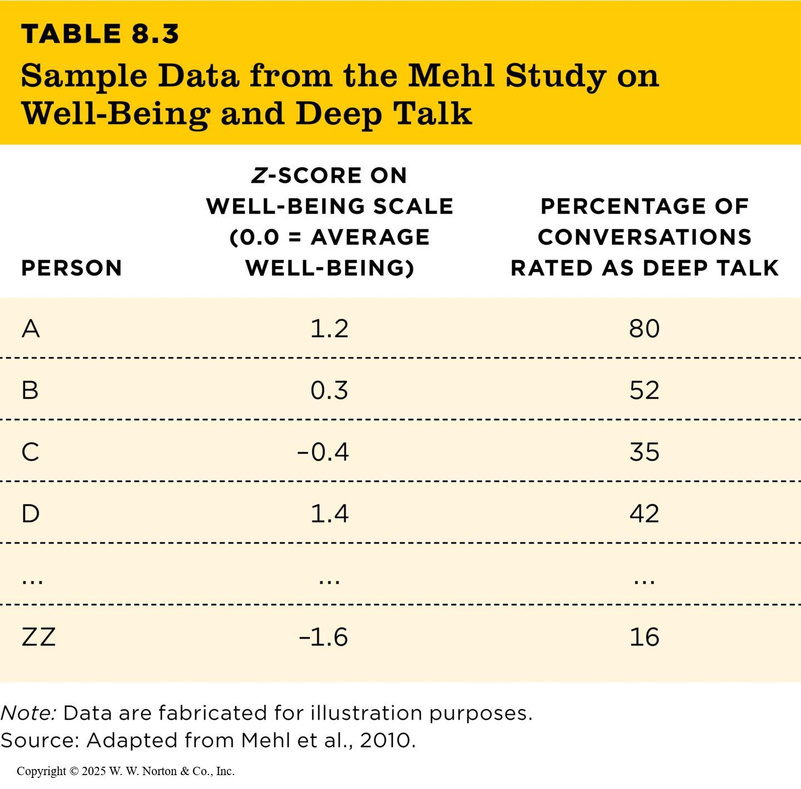
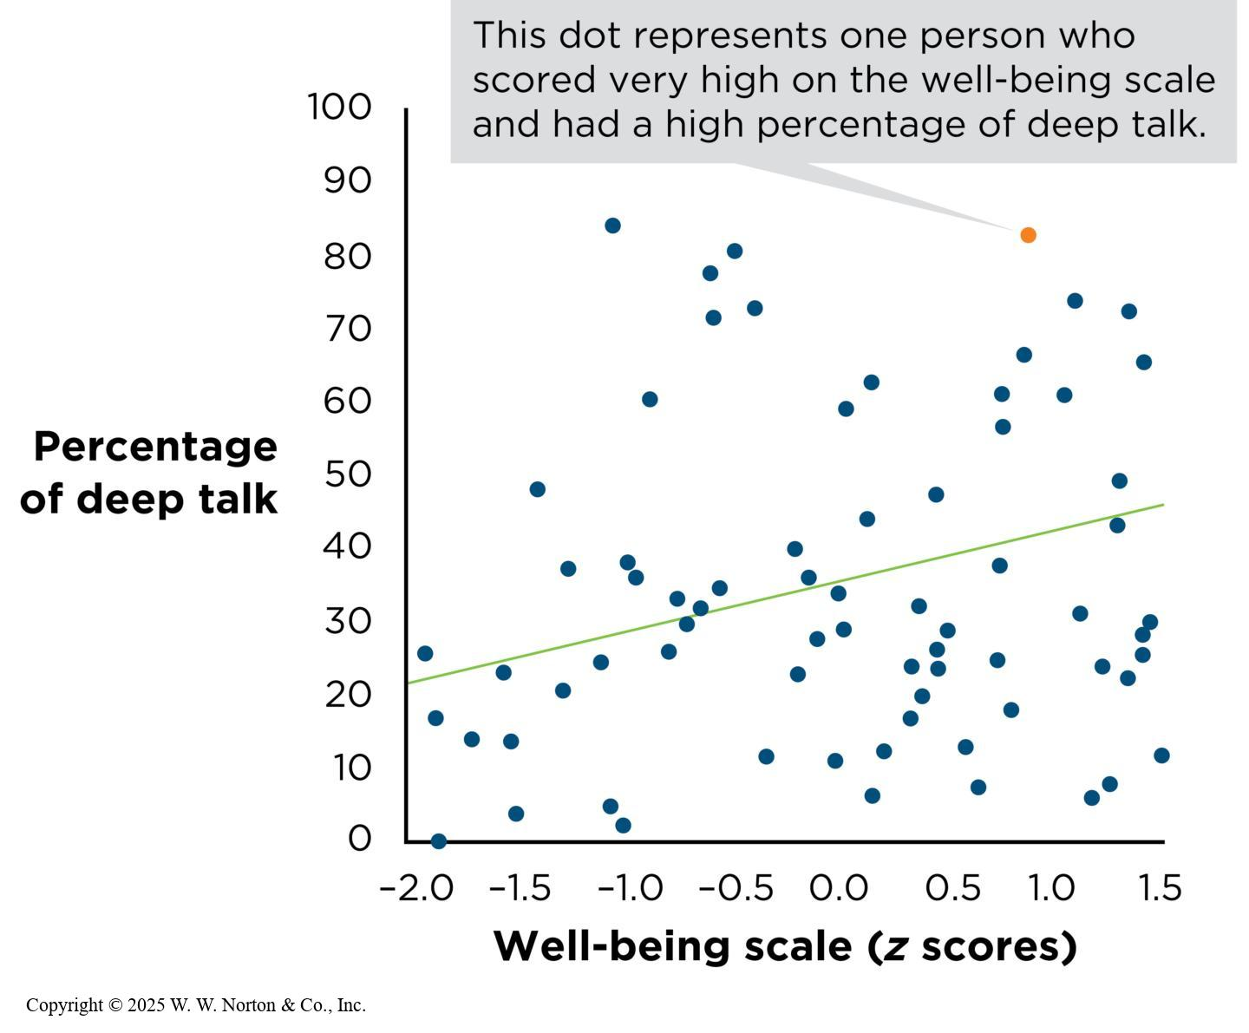
Describing Associations Between
Two Quantitative Variables (1 of 2)
TABLE 8.3
TABLE 8.3 Sample Data from the Mehl Study on Well-Being and Deep Talk
PERSON | z-SCORE ON
WELL-BEING SCALE (0.0 = AVERAGE WELL-BEING) | PERCENTAGE OF CONVERSATIONS RATED AS DEEP TALK
A | 1.2 | 80
B | 0.3 | 52
C | –0.4 | 35
D | 1.4 | 42
... | ... | ...
ZZ | –1.6 | 16
Note: Data are fabricated for illustration purposes. Source: Adapted from Mehl et al., 2010.
Notes:
Table 8.3: Sample Data from the Mehl Study on Well-Being and Deep-Talk
Notice that each row shows one person’s scores on two measured variables. Even though each study measured more than two variables, an analysis of bivariate correlations looks at only two variables at a time. Therefore, a correlational study might have measured multiple variables, but the authors present the bivariate correlations between different pairs of variables separately.
Copyright © 2025 W. W. Norton & Co., Inc.
Figure 8.1: Scatterplot of the Association Between Deep Talk and Well-Being
The scatterplot in Figure 8.1 shows the data from Mehl et al.’s (2010) research. The two quantitative variables are percentage of deep talk and z score on a well-being scale. By looking at the scatterplot, decide if the correlation is positive, negative, or zero. It is positive. The correlation coefficient is r = .28. This is a positive correlation (direction) of moderate strength (strength).
(Source: Adapted from Mehl et al., 2010.)
Copyright © 2025 W. W. Norton & Co., Inc.

Slide 7
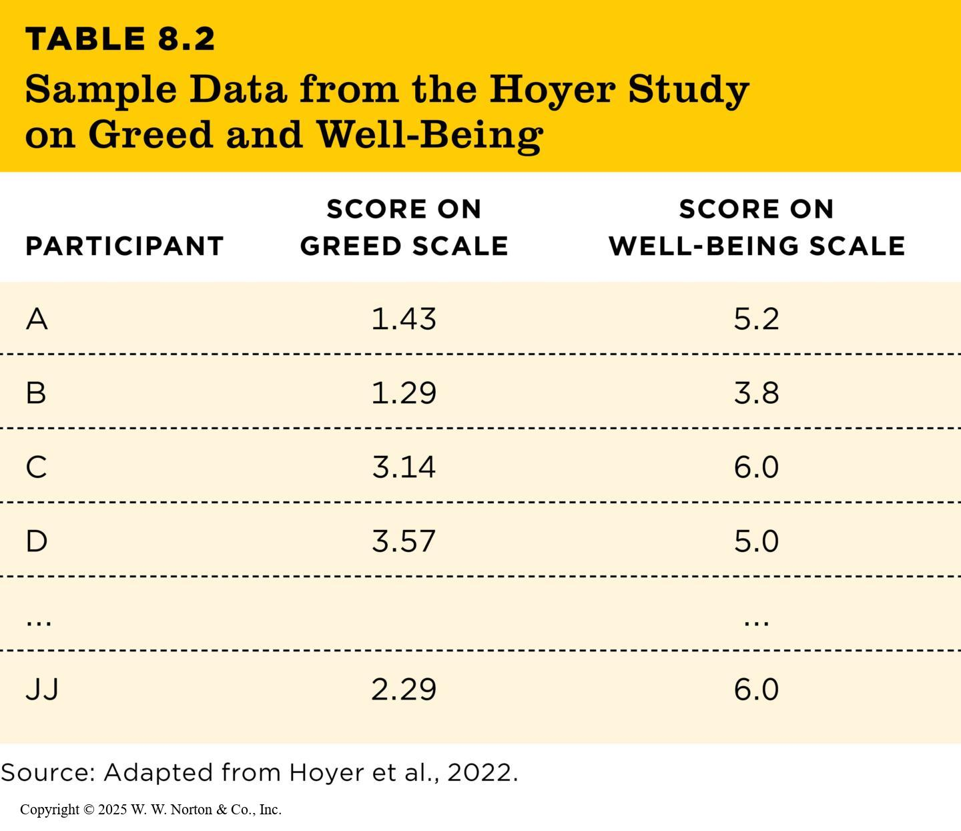
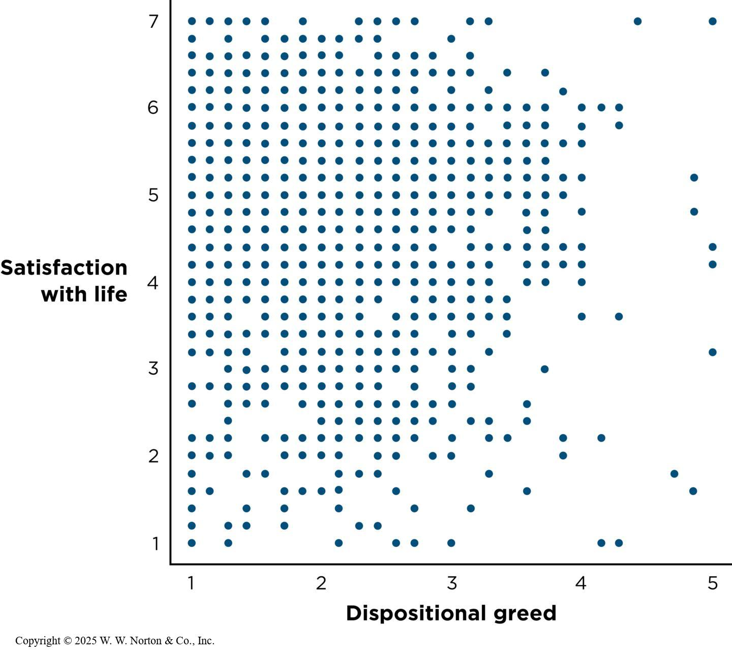
Describing Associations Between
Two Quantitative Variables (2 of 2)
TABLE 8.2
TABLE 8.2 Sample Data from the Hoyer Study on Greed and Well-Being
PARTICIPANT | SCORE ON GREED SCALE | SCORE ON WELL-BEING SCALE
A | 1.43 | 5.2
B | 1.29 | 3.8
C | 3.14 | 6.0
D | 3.57 | 5.0
... |  | ...
JJ | 2.29 | 6.0
Source: Adapted from Hoyer et al., 2022.
Notes:
Table 8.2: Sample Data from the Hoyer Study on Greed and Well-Being
Copyright © 2025 W. W. Norton & Co., Inc.
Figure 8.2: Scatterplot of the association between greed and well-being, based on a study of 2,367 adults.
Here is the scatterplot for a study by Hoyer et al. (2022), with the two variables representing the frequency of deep talk and levels of well-being. Is the correlation positive, negative, or zero? It is negative. The correlation coefficient (r) is –.14.
Does this cloud of points slope up or down? Is it a strong or a weak relationship? (Source: Adapted from data provided in Hoyer et al., 2022.)
Copyright © 2025 W. W. Norton & Co., Inc.

Slide 8
Describing Associations with Categorical Data
Correlation requires two measured (numeric) variables
  Graphing associations when one variable is categorical
  Analyzing associations when one variable is categorical
Notes:
This slide presents the subsection headings.

Slide 9
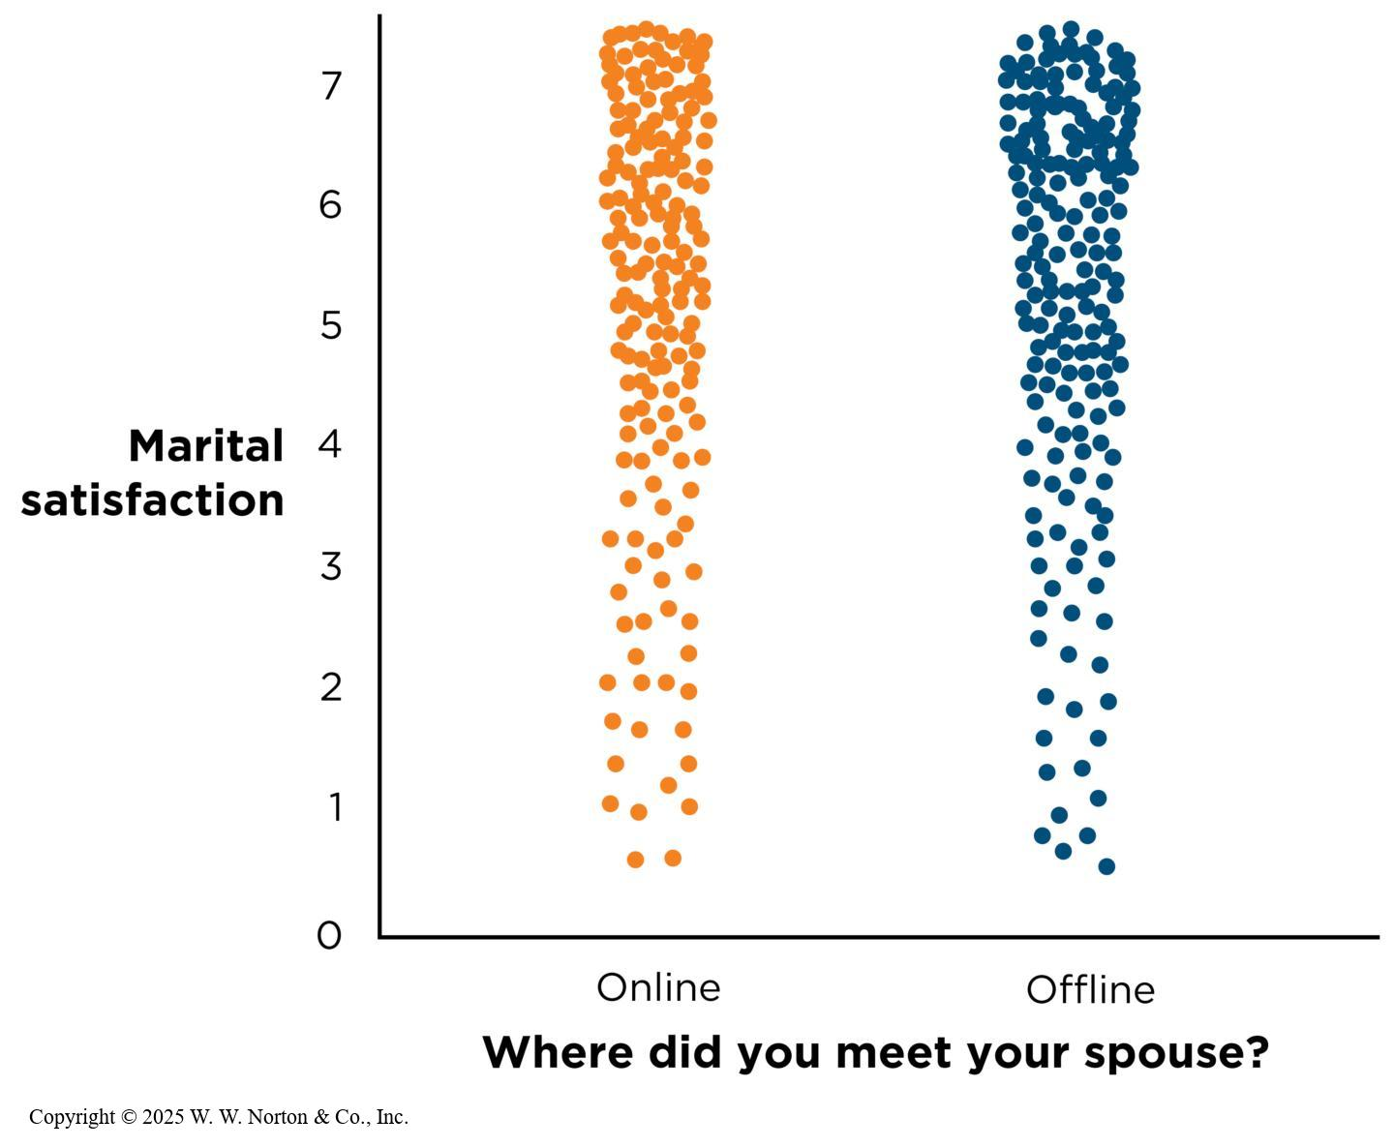
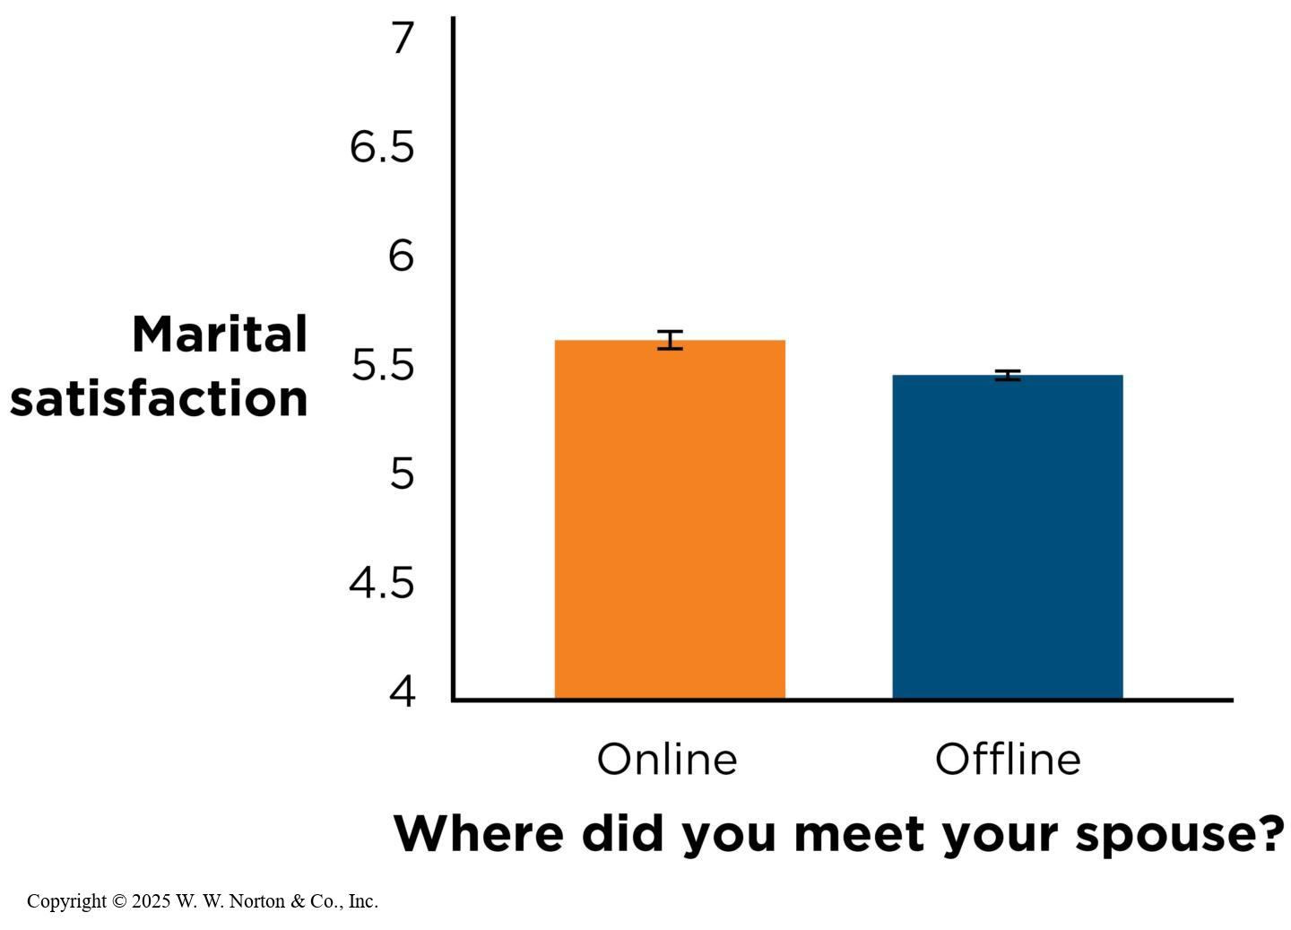
Graphing Associations When One Variable Is Categorical
Mean = arithmetic average
Notes:
Figure 8.3: Scatterplot of Meeting Location and Marital Satisfaction
Do you see an association here between meeting location and marital satisfaction? (The dots in this graph are “jittered,” which means that they are spread out horizontally so you can see more dots at once. Data are fabricated for illustration purposes.) (Source: Adapted from Cacioppo et al., 2013.)
Figure 8.3 is a scatterplot of data in which one variable (marital satisfaction) is quantitative and the other variable (where a person met their spouse) is categorical. The correlation between these two variables is r = .06.
Copyright © 2025 W. W. Norton & Co., Inc.
Figure 8.4: Bar Graph of Meeting Location and Marital Satisfaction
This is the same outcome as in Figure 8.3, graphed differently. Do you see an association here between meeting location and marital satisfaction? The error bars in this graph represent the 95% CI for each mean. These CIs are very narrow, reflecting the large sample size in the study. (Source: Adapted from Cacioppo et al., 2013.)
It’s much more common to plot the results of an association between one quantitative variable and one categorical variable in a bar graph (Figure 8.4). In a bar graph, each individual is not represented by a data point. Instead, the graph shows the group mean (average) for marital satisfaction for those who met their spouse online and the average for those who met their spouse offline. The online mean is slightly higher than the offline mean, corresponding to a weak association between the two variables.
Copyright © 2025 W. W. Norton & Co., Inc.

Slide 10
Interrogating Association Claims
Construct validity: How well was each variable measured?
Statistical validity: How well do the data support the conclusion?
Internal validity: Can we make a causal inference from an association?
External validity: To whom can the association be generalized?
Notes:
Association claims can be graphed using scatterplots or bar graphs, and they can be made using r or differences between means. When making an association claim, the kind of graph you make or the kind of statistic you use aren’t important, but having two measured variables is.

Slide 11
Construct Validity
Ask about the construct validity of each variable.
  How well was each of the variables measured?
  Does the measure have good reliability?
  Is it measuring what it’s intended to measure?
  What is the evidence for its face validity, for its concurrent validity, and for its discriminant and convergent validity?
Notes:
For example: In the Mehl study, you would ask questions about the researchers’ operationalizations of deep talk and well-being.
Recall that deep talk in this study was observed via the EAR recordings and coded later by research assistants, while well-being was measured using the subjective well-being (SWB) scale.

Slide 12
Statistical Validity
  How strong is the relationship?
  How precise is the estimate?
  Has it been replicated?
  Could outliers be affecting the association?
  Is there restriction of range?
  Is the association curvilinear?
Notes:
When considering the statistical validity of an association claim, you need to consider the strength and statistical significance of the relationships, any outliers, the restriction of the range, and the possibility of a curvilinear relationship.

Slide 13
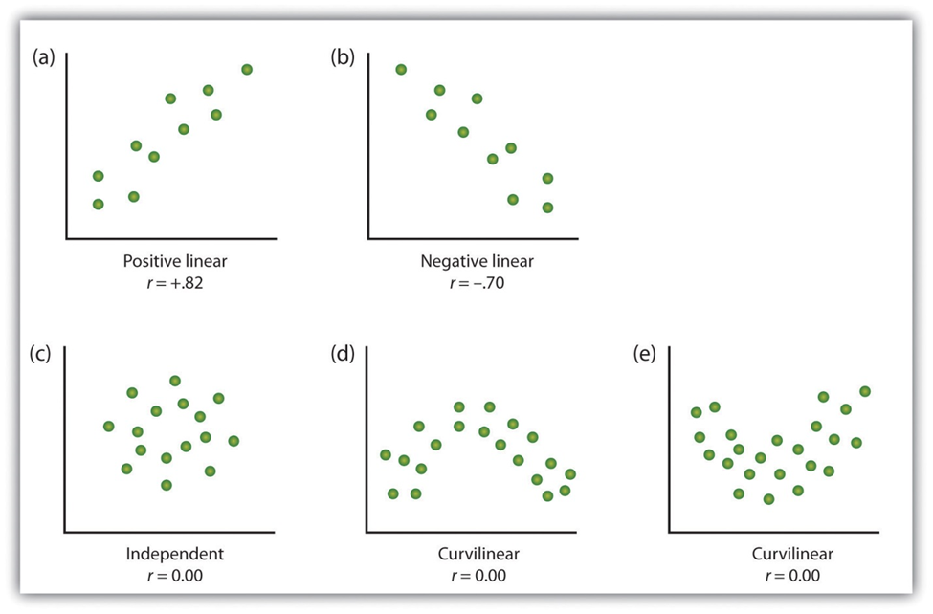
Linear and Non-linear Relationships

Slide 14
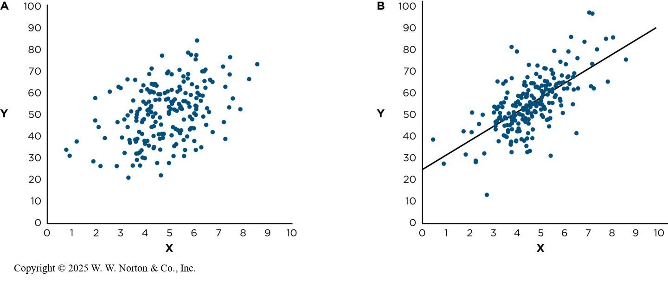
How Strong is the Relationship?
Effect size: describes the strength of an association
Notes:
Figure 8.5: Two Scatterplots Depicting Different Association Strengths
Both of these are positive associations. Which scatterplot shows the stronger relationship, part A or part B?
Some associations are stronger than others, and the effect size describes the strength of the association. In Figure 8.5, both associations are positive, but B is a stronger association (r is closer to 1) than A. Therefore, B depicts a stronger effect size.
Copyright © 2025 W. W. Norton & Co., Inc.

Slide 15

Evaluating Effect Size
All else being equal, larger effect sizes are more important
“Small” effect sizes can compound over many observations
Benchmarks: “compared to what?
Notes:
Figure 8.6: Tiny Effects Can Add Up
The correlation between the personality trait of agreeableness and the success of a single social interaction may be “only” .07, but if this effect is aggregated over the course of a couple hundred social interactions, an agreeable person may actually be more popular than a less agreeable person (Funder & Ozer, 2019).
Effect sizes can also indicate the importance of a result. A larger effect size is usually considered more important than a small one, when all else is equal. However, there are some exceptions. Depending on the context, even a small effect size can be important.
For example, when a seemingly small effect size is aggregated (combined) over many observations, it can have an important impact. In baseball, star batters are only slightly better at getting on base than average batters, (r + .05), but over the course of a full season of baseball with more than 550 at-bats, this seemingly small effect size translates to many more runs.
ZUMA Press Inc/Alamy Stock Photo

Slide 16
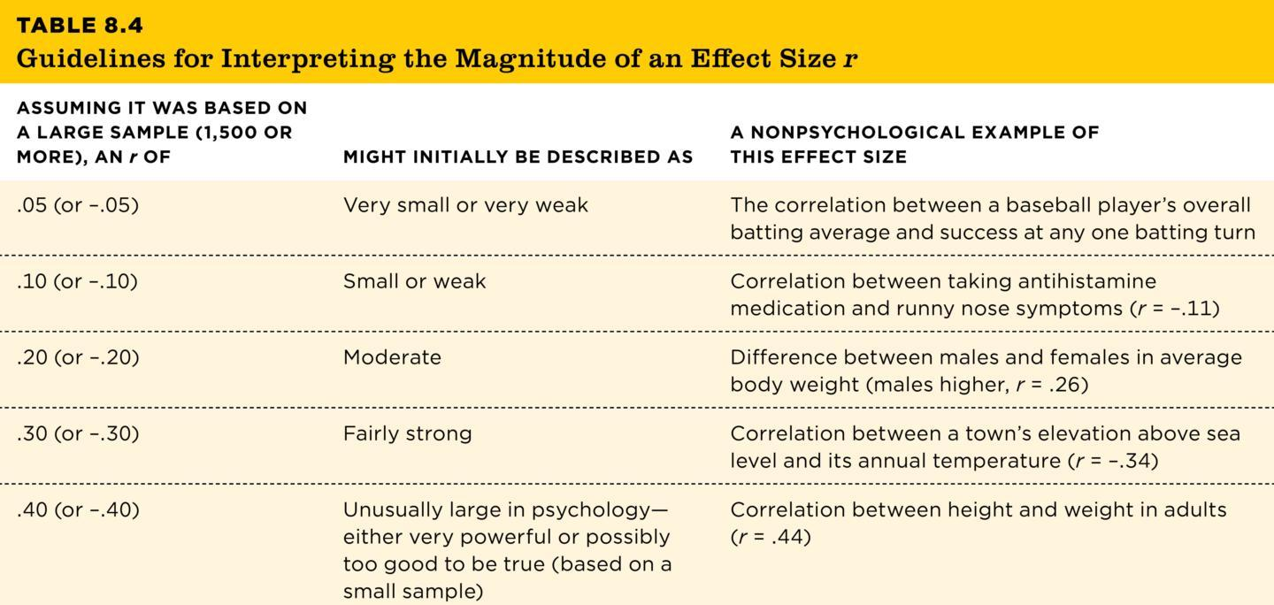
Benchmarks: Compared to What?
TABLE 8.4
TABLE 8.4 Guidelines for Interpreting the Magnitude of an Effect Size r
ASSUMING IT WAS BASED ON A LARGE SAMPLE (1,500 OR MORE), AN r OF | MIGHT INITIALLY BE DESCRIBED AS | A NONPSYCHOLOGICAL EXAMPLE OF THIS EFFECT SIZE
.05 (or –.05) | Very small or very weak | The correlation between a baseball player’s overall batting average and success at any one batting turn
.10 (or –.10) | Small or weak | Correlation between taking antihistamine medication and runny nose symptoms (r = –.11)
.20 (or –.20) | Moderate | Difference between males and females in average body weight (males higher, r = .26)
.30 (or –.30) | Fairly strong | Correlation between a town’s elevation above sea level and its annual temperature (r = –.34)
.40 (or –.40) | Unusually large in psychology—either very powerful or possibly too good to be true (based on a small sample) | Correlation between height and weight in adults (r = .44)
Sources: Funder & Ozer, 2019; also Abelson, 1995; Kraft, 2020; Meyer et al., 2001; Ozer & Benet-Martìnez, 2006.
Notes:
Table 8.4: Guidelines for Interpreting the Magnitude of an Effect Size r
We can also think about an effect size by comparing it to well-understood benchmarks. Remember that the average effect size in psychology is around r = .20 and rarely as high as r = .40. based on the descriptions in Table 8.4, we might conclude that the r = .26 from the Mehl study was fairly typical, and that the association of r = -.37 in the Siddarth study was fairly large. As we discuss in the next section, we may question whether it was actually too large.
Copyright © 2025 W. W. Norton & Co., Inc.

Slide 17
How Precise is the Estimate? (1 of 2)
Sample size and precision
CIs that do not contain zero
CIs that do contain zero
Notes:
When we ask how precise a point estimate is, we are really asking how wrong it could be. Researchers convey the precision with a 95% confidence interval (95% CI), which ensure that 95% of the Cls will contain the true population correlation.
A 95% CI also gives us a sense of what to expect from the next study. We’d be surprised if the next study’s estimate is outside the CI.
Estimates based on a smaller sample size are less stable, leading to wider and less precise Cis. In contrast, larger samples result in much narrower, more precise confidence intervals. Recall the association between where people meet their spouse and their marital satisfaction, r = .06. the sample size was 19,000 people, and the resulting CI was quite narrow [.05, .07].

Slide 18
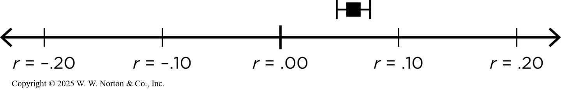
How Precise is the Estimate? (2 of 2)
Notes:
Figure 8.7: 95% CI for the Association Between Meeting One’s Spouse Online and Marital Satisfaction
This CI is very narrow, reflecting the very large sample in this study.
The confidence interval for meeting one’s spouse online [.05 , .07] does not contain zero, so we can infer that the true relationship is unlikely to be zero, and it is commonly said that the association therefore has statistical significance. This means that this finding is unlikely to have come from a population in which the association is zero.
Copyright © 2025 W. W. Norton & Co., Inc.

Slide 19
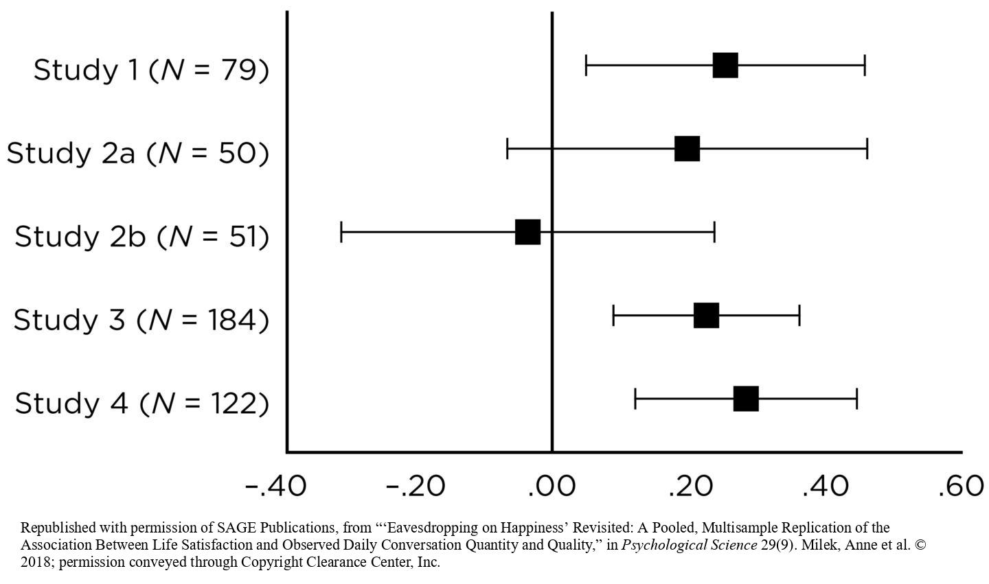
Has It Been Replicated?
Replicated
Notes:
Figure 8.9: Multiple Estimates of the Association Between Substantive Conversations and Well-Being
Milek et al. (2018) computed five estimates. Each correlation (r) is plotted as a black square. Most estimates are to the right of the solid vertical line representing zero, which means that the estimate is a positive relationship. The wings on each side of the square indicate the width of the 95% CI. The vertical line on the graph marks a zero association. As you can see, the 95% CI for three of the five correlations did not include zero. (Source: Computed from open data provided by Milek et al., 2018.)
The figure shows the results obtained by a research team who replicated, or conducted again, the deep talk and well-being study from earlier in this chapter. They obtained four additional estimates of the associations, which are shown on the slide.
Republished with permission of SAGE Publications, from “‘Eavesdropping on Happiness’ Revisited: A Pooled, Multisample Replication of the Association Between Life Satisfaction and Observed Daily Conversation Quantity and Quality,” in Psychological Science 29(9). Milek, Anne et al. © 2018; permission conveyed through Copyright Clearance Center, Inc.

Slide 20
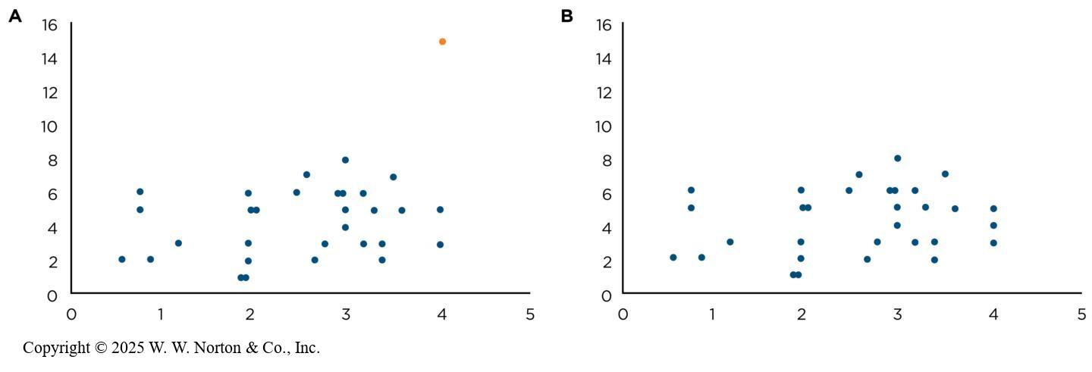
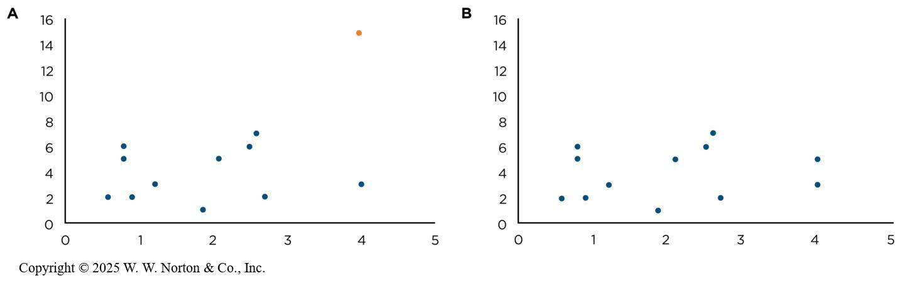
Could Outliers Be Affecting the Association?
Outlier
Notes:
Figure 8.10: The Effects of an Outlier
These two scatterplots are identical, except for the outlier in the top-right corner of part A. (A) r = .37. (B) r = .26.
Copyright © 2025 W. W. Norton & Co., Inc.
Figure 8.11: Outliers Matter Most When the Sample Is Small
Again, these two scatterplots are identical except for the outlier. But in this case, removing the outlier changed the correlation from r = .49 to r = .15; this is a much bigger jump than in Figure 8.10, which has more data points.
Outlier: one or more extreme scores that lie far away from the rest of the scores. The two scatterplots in Figure 8.9 are identical except for the outlier in the upper right-hand corner in the left scatterplot. The correlation coefficient for the left graph is r = .37 and for the right graph is r = .26. Outliers can cause problems for association claims because they may exert a large amount of influence. In bivariate correlations, outliers are most problematic when they involve extreme scores on both variables.
Outliers are most influential when the sample is small (see Figure 8.10). The two scatterplots are identical except for the outlier. Removing the outlier changes the correlation from .49 to .15, which is much bigger than the change from .37 to .26 that you saw in Figure 8.9.
Copyright © 2025 W. W. Norton & Co., Inc.

Slide 21
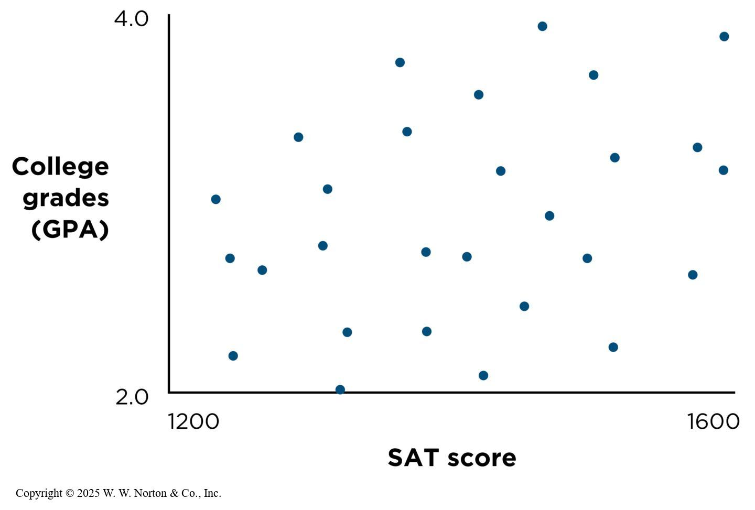
Is There Restriction of Range?
Restriction of range
Notes:
Figure 8.12: Correlation Between SAT Scores and First-Year College Grades
College S might observe a scatterplot like this for its enrolled students. (Data are fabricated for illustration purposes.)
Restriction of range: When there is not a full range of scores on one of the variables in an association in a correlational study, it can make the correlation appear smaller than it really is.
If you look at the graph, you will see that the two variables are college grades (GPA) and SAT score. The data are from a highly selective college (College S) that only admits students with high SAT scores. A plot of the correlation between college grades and SAT score for students at College S yields a positive relationship but the relationship doesn’t appear to be very strong.
Copyright © 2025 W. W. Norton & Co., Inc.

Slide 22
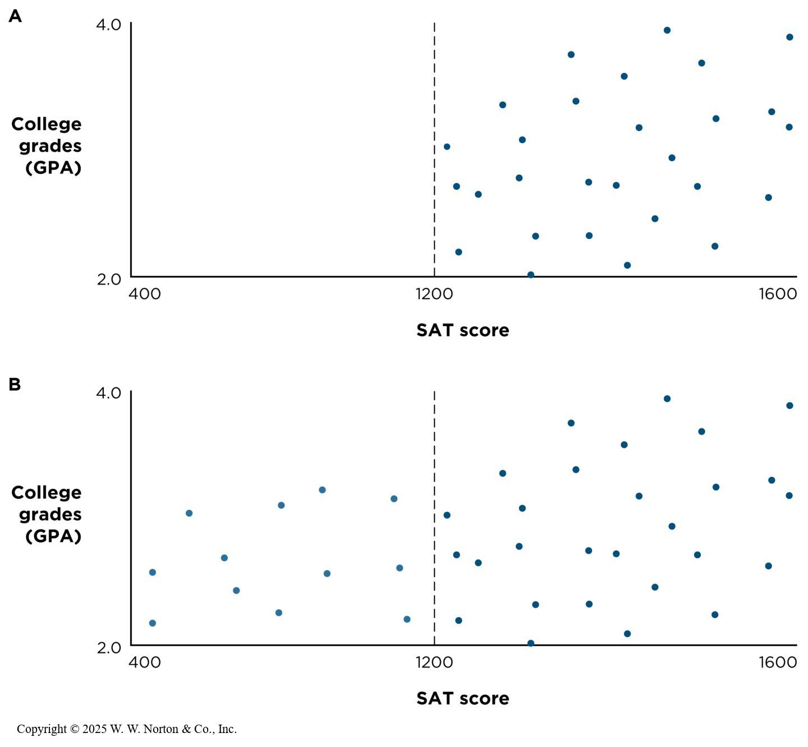
Is There Restriction of Range? SAT Range
Notes:
Figure 8.13: Restriction of Range Underestimates the True Correlation
(A) College S admits only those students whose SAT scores are above 1200, so its observed correlation between SAT and GPA is about r = .33. (B) If we could include estimates of the scores for students who were not admitted, the correlation between SAT and GPA would be stronger, about r = .57. (Data are fabricated for illustration purposes.)
SAT scores can range from 400 to 1600, but College S only admits students who score 1200 or higher (restriction of range in Figure 8.12A). Thus, the range is restricted to 1200 to 1600. If we extrapolate from the top scatterplot, we can see what the scatterplot would look like if the range was not restricted (see Figure 8.13B). In the top scatterplot, r = .33. In the bottom scatterplot, where the range is not restricted, the correlation is stronger (r = .57). What can researchers do about restriction of range? There are statistical techniques that allow correction for restriction of range, or researchers can recruit more participants to try to widen the range.
Copyright © 2025 W. W. Norton & Co., Inc.

Slide 23
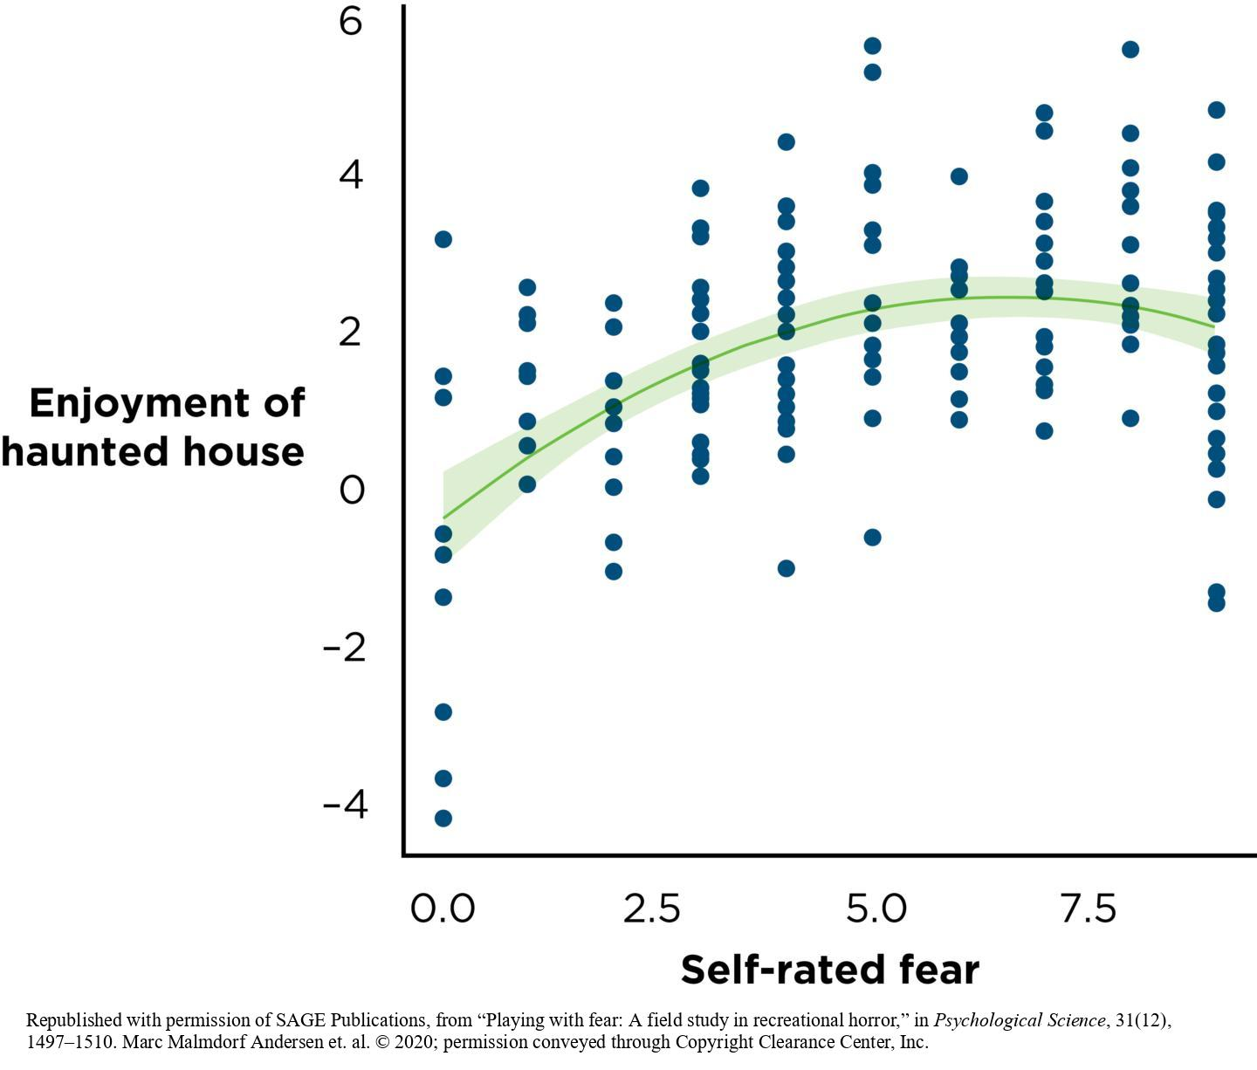
Is the Association Curvilinear?
Curvilinear association
Notes:
Figure 8.14: A Curvilinear Association
Among visitors to a haunted house, the more scared people felt, the more they enjoyed the experience—but only up to a point. After that “sweet spot,” the relationship reversed direction, such that as people became very scared, their enjoyment ratings dropped. This curvilinear association is not captured adequately by the simple bivariate correlation coefficient r, which can only depict a straight line. Curvilinear relationships are best evaluated by squaring one of the variables. (Source: Adapted from Andersen et al., 2020.)
Curvilinear association: one in which the correlation coefficient is zero (or close to zero), and the relationship between two variables isn’t a straight line
Among visitors to a haunted house, the more scared people felt, the more they enjoyed the experience—but only up to a point. After that “sweet spot,” the relationship reversed direction, such that as people became very scared, their enjoyment ratings dropped. This curvilinear association is not captured adequately by the simple bivariate correlation coefficient r, which can only depict a straight line. Curvilinear relationships are best evaluated by squaring one of the variables. (Source: Adapted from Andersen et al., 2020.)
Republished with permission of SAGE Publications, from “Playing with fear: A field study in recreational horror,” in Psychological Science, 31(12), 1497–1510. Marc Malmdorf Andersen et. al. © 2020; permission conveyed through Copyright Clearance Center, Inc.

Slide 24
Internal Validity
Applying the three causal criteria
More on internal validity: When is the potential third variable a problem?
Notes:
This slide presents the section headings.
Although it’s not a priority to interrogate internal validity when making an association claim, we still want to consider internal validity because we want to be aware of the causal temptation to turn an association claim into a causal claim.

Slide 25
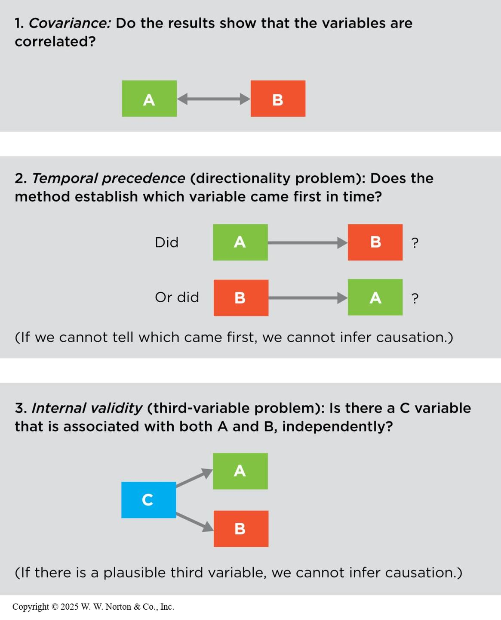
Applying the Three Causal Criteria
Covariance
Temporal precedence
Internal validity (third-variable problem)
Notes:
Figure 8.15: The Three Criteria for Establishing Causation
When variable A is correlated with variable B, does that mean A causes B? To decide, apply the three criteria.
Correlation is not causation. In order to make a causal claim, a study has to satisfy these three criteria:
Covariance: There must be an association between the cause variable (A) and the effect variable (B).
Temporal precedence (the directionality problem): The causal variable (A) must come before the effect variable (B).
Internal validity (third-variable problem): Is there a third variable (C) that is associated with variables A and B independently? If so, then we can’t infer causation.
Copyright © 2025 W. W. Norton & Co., Inc.

Slide 26
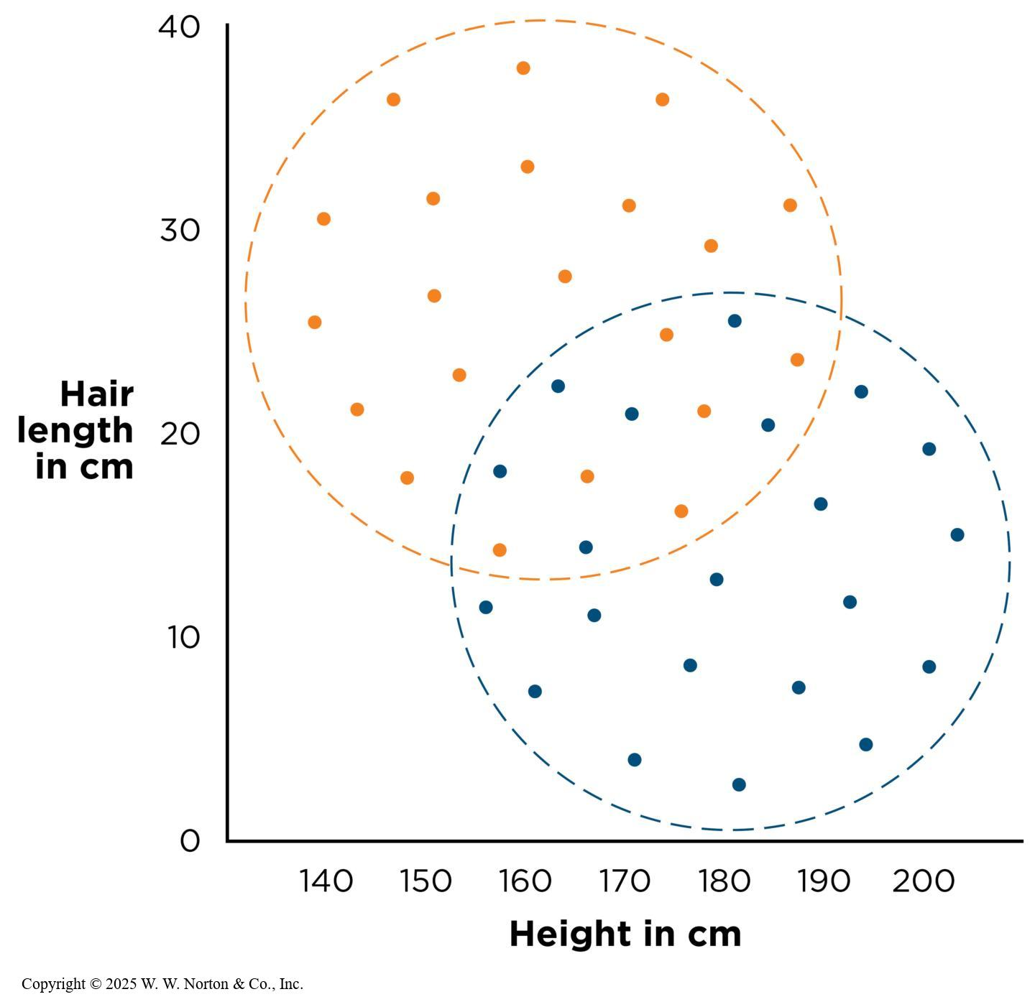
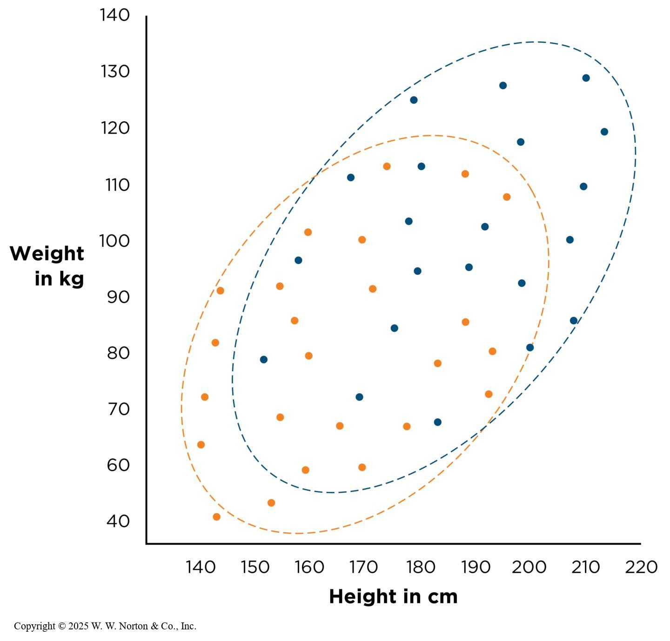
More on Internal Validity:
When Is That Potential Third Variable a Problem?
Notes:
Figure 8.16: A Third Variable, Gender: An Internal Validity Problem
Women (orange dots) are both higher in hair length and lower in height, compared with men (blue dots). Within each gender group, there is no relationship between these two variables. This outcome means that gender is really the reason hair length and height are negatively correlated. (Data are fabricated for illustration purposes.)
Copyright © 2025 W. W. Norton & Co., Inc.
Figure 8.17: A Third Variable, Gender: Not an Internal Validity Problem
Women (orange dots) are lower in both height and weight than men (blue dots). However, within each gender group there is still a positive relationship between height and weight. This outcome means that gender does not actually pose an internal validity problem in this relationship; height and weight are still correlated even within the two gender subgroups. (Data are fabricated for illustration purposes.)
When we come up with a third-variable explanation for an association, how do we know if it poses a problem for internal validity? Figure 8.16 shows a scatterplot depicting the correlation between height and hair length, but with the data divided into a third categorical variable, gender.
Overall, there is a moderate, positive relationship between deep talk and happiness. But look what happens when we separate the participants into two subgroups based on gender. The orange dots represent women, who tend to be shorter and have longer hair, and the blue dots represent men, who tend to be taller and have shorter hair.
If we look at the two subgroups separately, there is no positive association. Thus, the only reason why height and hair length are correlated is because of the trends among men and women. Therefore, gender presents a third-variable problem, and we refer to the relationship between height and hair-length as a spurious association (one that is only present because of a third variable).
The scatterplot in Figure 8.17 illustrates how the results could have come out differently. If you look at the orange dots (women) separately, you see that there is still a positive association between height and weight. If you look at only the blue dots (men), there is a positive correlation between height and weight. Although gender might be a third-variable explanation for the result, height and weight are nonetheless correlated within subgroups of men and women. Thus, in this case, there is not an internal validity problem.
Copyright © 2025 W. W. Norton & Co., Inc.

Slide 27
External Validity
How important is external validity?
Moderating variables
Notes:
This slide presents the section headings.
Does the association generalize to other people, places, and times? It is important to note that the size of the sample does not matter as much as the way the sample was selected from the population of interest.

Slide 28
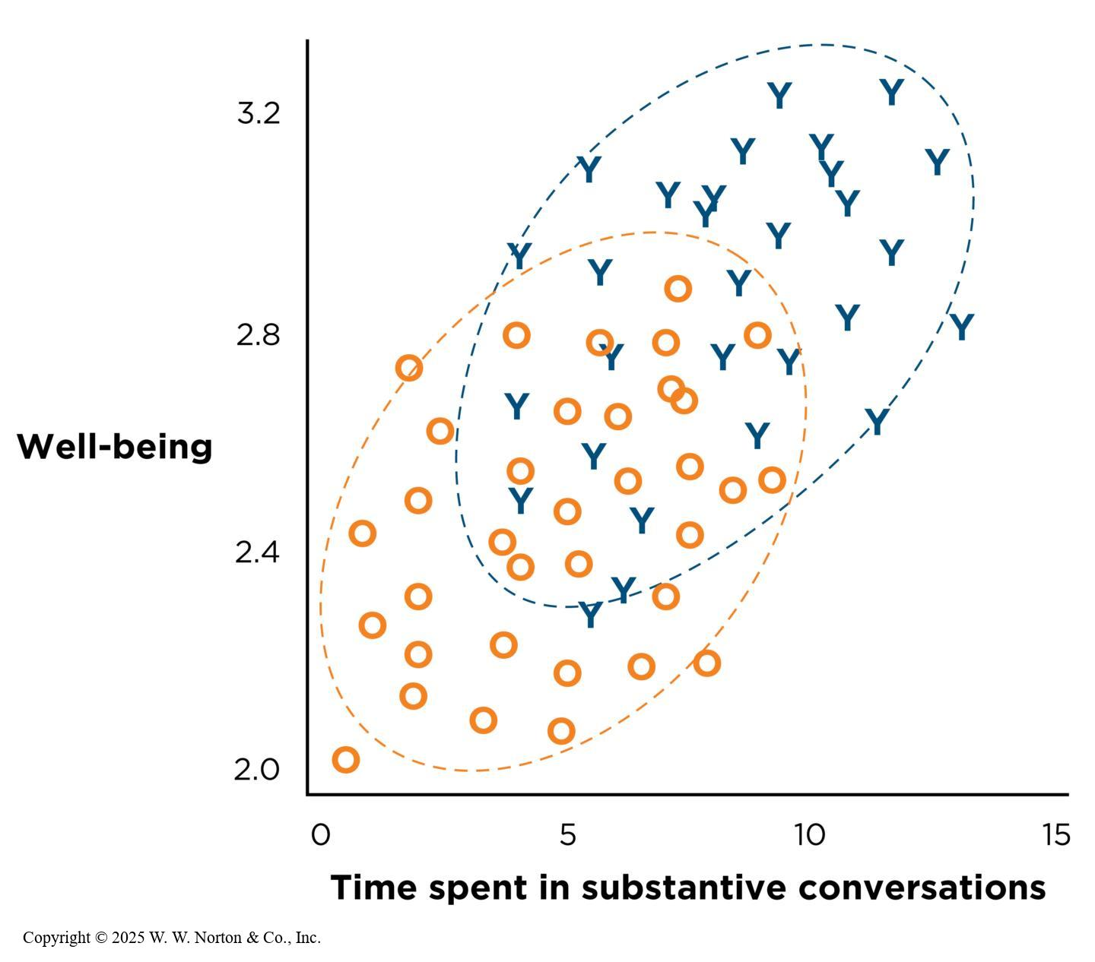
How Important Is External Validity?
Notes:
Figure 8.18: An Association in Two Different Samples
Older adults (represented by O) might spend less time in deep conversation than college students (Y), and they might have lower well-being. But the association between the two variables within each sample of people may exist. (Data are fabricated for illustration purposes.)
If a bivariate correlational study fails to use a random sample, it should not cause us to automatically reject the association. Instead, we can accept the results as they are and save the question of generalizability for another study that tests the same variables in a different population. Also, many associations generalize to samples that are very different from the original sample.
Older adults (represented by O) might spend less time in deep conversation than college students (Y), and they might have lower well-being. But the association between the two variables within each sample of people may exist.
(Data are fabricated for illustration purposes.)
Copyright © 2025 W. W. Norton & Co., Inc.

Slide 29
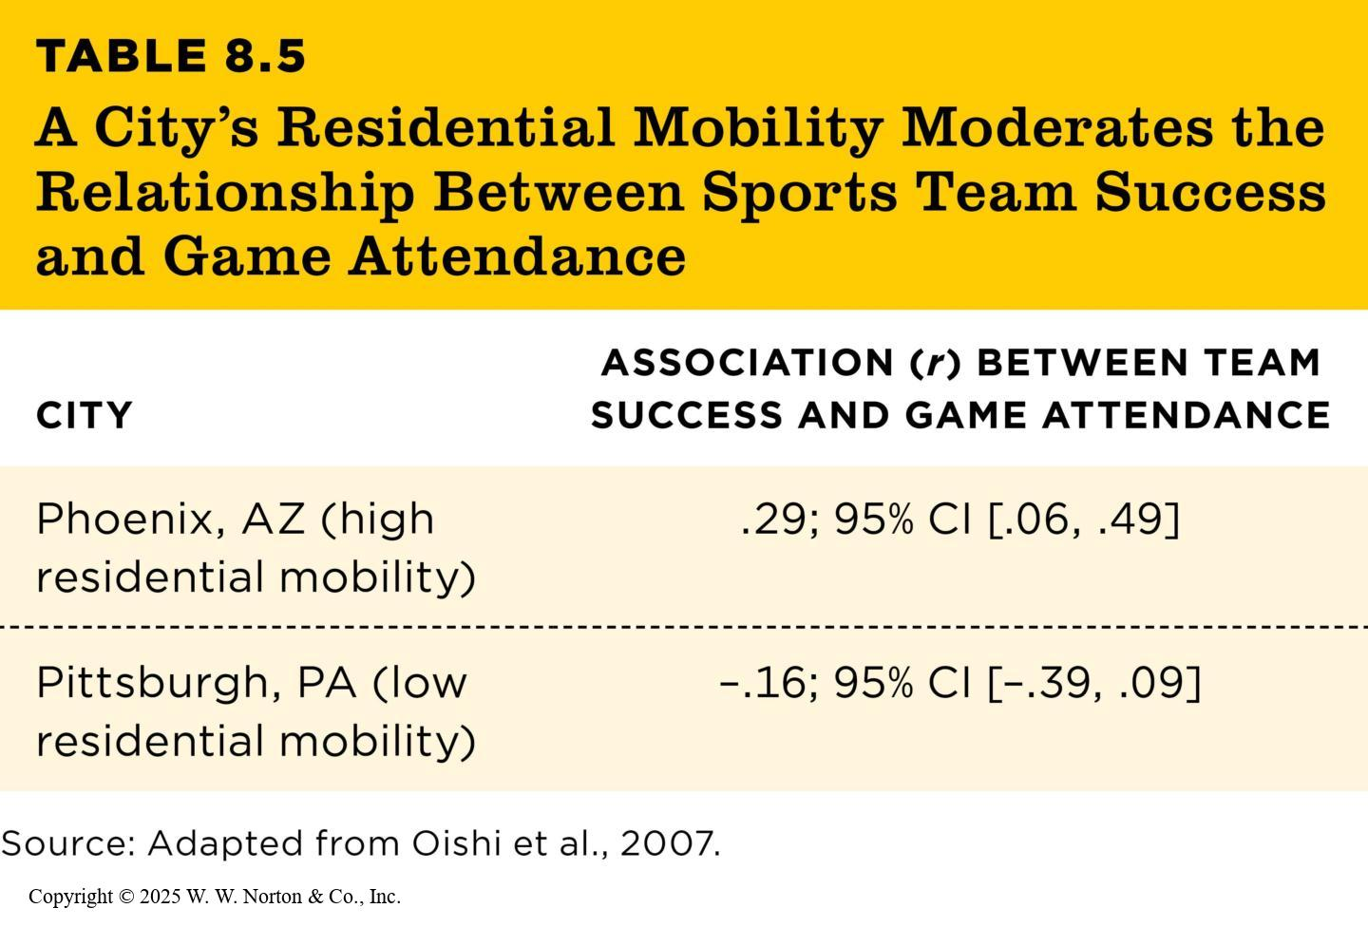
Moderating Variables (1 of 2)
Moderator
TABLE 8.5
TABLE 8.5 A City’s Residential Mobility Moderates the Relationship Between Sports Team Success and Game Attendance
CITY | ASSOCIATION (r) BETWEEN TEAM SUCCESS AND GAME ATTENDANCE
Phoenix, AZ (high residential mobility) | .29; 95% CI [.06, .49]
Pittsburgh, PA (low residential mobility) | –.16; 95% CI [–.39, .09]
Source: Adapted from Oishi et al., 2007.
Notes:
Table 8.5: A City’s Residential Mobility Moderates the Relationship Between Sports Team Success and Game Attendance
When the relationship between two variables changes depending on the level of another variable, that other variable is called a moderator.
Example: Let’s consider a study on the correlation between professional sports games attendance and the success of the team. Using data gathered over many major league baseball seasons, Oishi and his team determined that in cities with high residential mobility, there is a positive correlation between success and attendance, indicating a fair-weather fan base. In cities with low residential mobility, there is not a significant correlation between success and attendance. We say that the degree of residential mobility moderates the relationship between success and attendance. (Source: Adapted from Oishi et al., 2007.)
Copyright © 2025 W. W. Norton & Co., Inc.

Slide 30
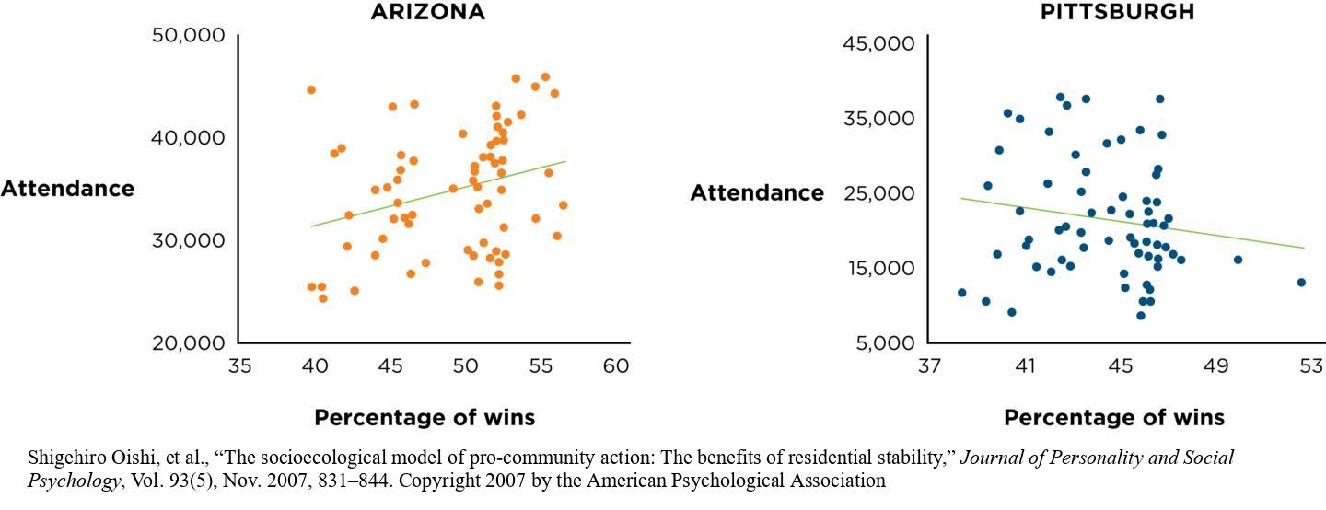
Moderating Variables (2 of 2)
Notes:
Figure 8.19: A Moderating Variable
A city’s degree of residential mobility moderates the relationship between local sports team success and attendance at games. Each dot represents one major league baseball season. The Arizona Diamondbacks are based in Phoenix, a city with high residential mobility; that pattern shows people are more likely to attend games there when the team is having a winning season. Pittsburgh is a city with low residential mobility; that pattern shows Pittsburgh Pirates fans attend games regardless of whether the team is having a winning season. (Source: Adapted from Oishi et al., 2007.)
Shigehiro Oishi, et al., “The socioecological model of pro-community action: The benefits of residential stability,” Journal of Personality and Social Psychology, Vol. 93(5), Nov. 2007, 831–844. Copyright 2007 by the American Psychological Association

